Slide 1
The Basics of Graphs

Slide 2
Basic Definitions

Slide 3
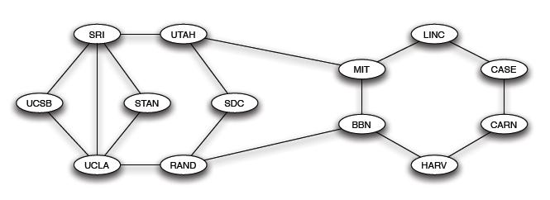
Example
This graph represents ARPANET (the first packet-switching network, the progenitor of the Internet) in 1970:
edge
vertex

Slide 4
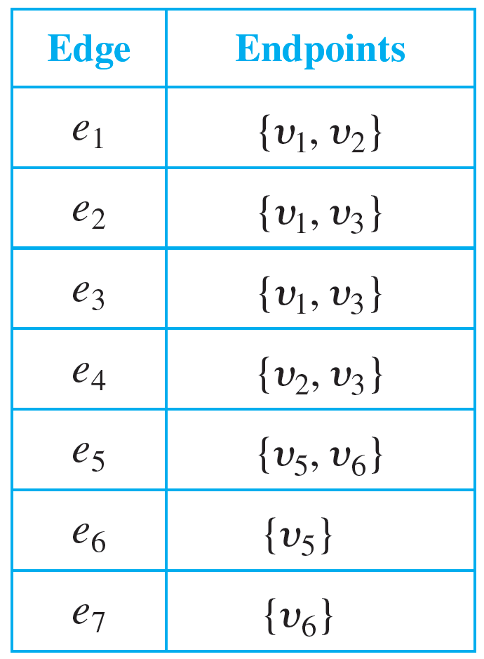
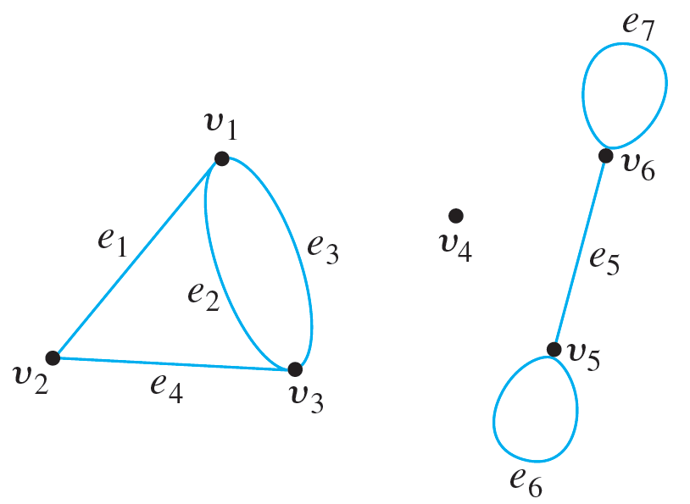

Definition
Definition. A graph $G=(V, E)$ consists of two finite sets: a nonempty set $V$ of vertices and a set $E$ of edges, where each edge is associated with a set consisting of either one or two vertices called its endpoints.
Example
$V=\{v_{1},…,v_{6}\}$
$E=\{e_{1},…, e_{7}\}$

Slide 5
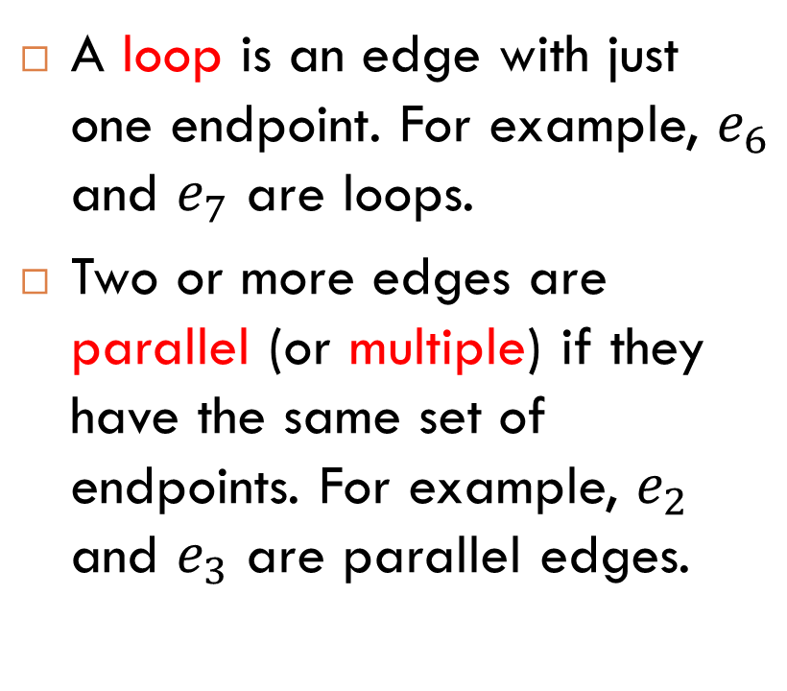
More Terminology
A loop is an edge with just one endpoint. For example, $e_{6}$ and $e_{7}$ are loops.
Two or more edges are parallel (or multiple) if they have the same set of endpoints. For example, $e_{2}$ and $e_{3}$ are parallel edges.
loops
parallel edges

Slide 6
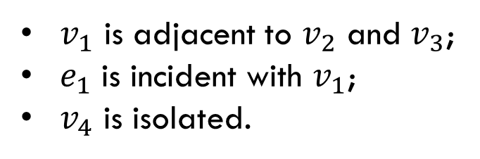
More Terminology (cont.)
Two vertices are adjacent if they are endpoints of the same edge. Adjacent vertices are also called neighbors.
An edge connects its endpoints. We also say that an edge is incident with its endpoint.
A vertex with which no vertex is incident is called isolated.
Examples
$v_{1}$ is adjacent to $v_{2}$ and $v_{3}$;
$e_{1}$ is incident with $v_{1}$;
$v_{4}$ is isolated.

Slide 7
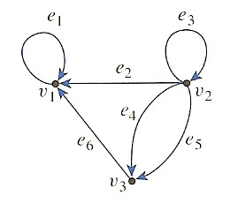
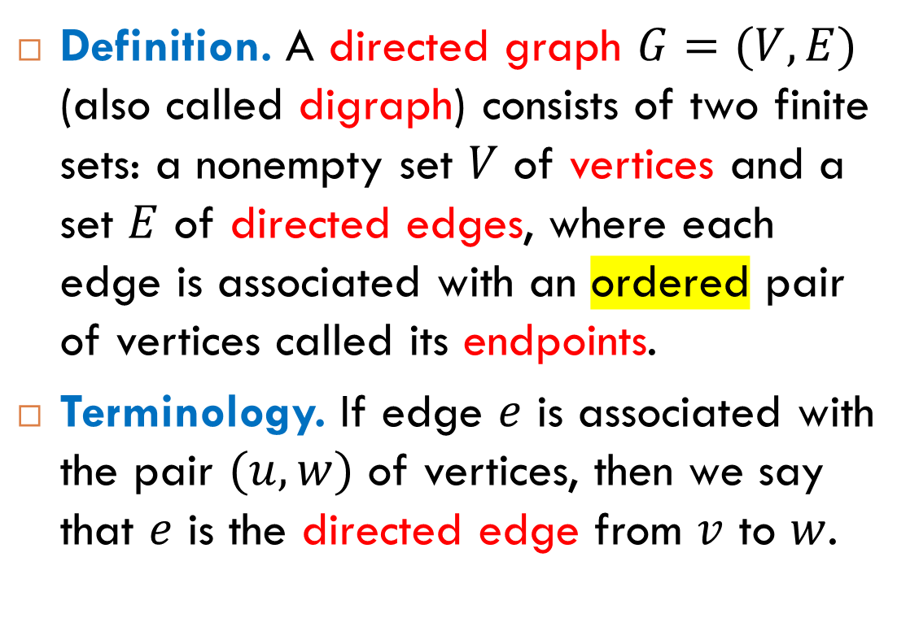
Directed Graphs
Definition. A directed graph $G=(V, E)$ (also called digraph) consists of two finite sets: a nonempty set $V$ of vertices and a set $E$ of directed edges, where each edge is associated with an ordered pair of vertices called its endpoints.
Terminology. If edge $e$ is associated with the pair $(u,w)$ of vertices, then we say that $e$ is the directed edge from $v$ to $w$.
Example

Slide 8
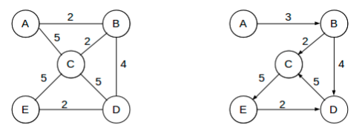
Weighted Graphs
Definition. A weighted graph is a graph in which each edge has an associated real number called the weight (or length) of the edge. Weighted directed graphs are defined similarly.

Slide 9
Vertex Degrees

Slide 10
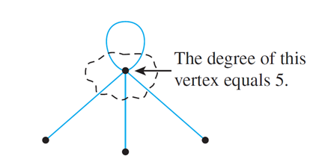

Degree of a Vertex
Definition. Let $G$ be a graph and $v$ a vertex of $G$. The degree of $v$, denoted $deg⁡(v)$, equals the number of edges that are incident on $v$, with an edge that is a loop counted twice.

Slide 11
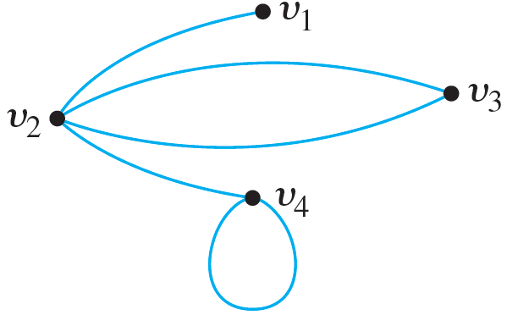

Total Degree
Definition. The total degree of a graph is the sum of the degrees of all vertices of the graph.
Example
$$\deg\left(v_{1}\right)=1$$
$$\deg\left(v_{2}\right)=4$$
$$\deg\left(v_{3}\right)=2$$
$$\deg\left(v_{4}\right)=3$$
The total degree equals $10$.

Slide 12
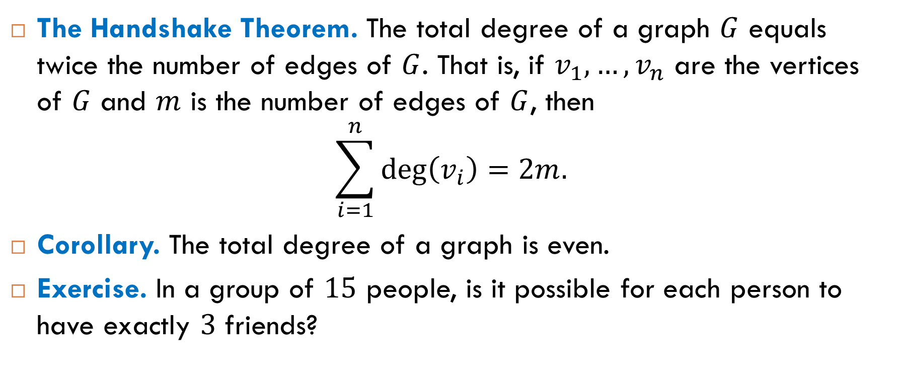
The Handshake Theorem
The Handshake Theorem. The total degree of a graph $G$ equals twice the number of edges of $G$. That is, if $v_{1},…, v_{n}$ are the vertices of $G$ and $m$ is the number of edges of $G$, then
$$\sum_{i=1}^{n}{\deg\left(v_{i}\right)=2m.}$$
Corollary. The total degree of a graph is even.
Exercise. In a group of $15$ people, is it possible for each person to have exactly $3$ friends?

Slide 13
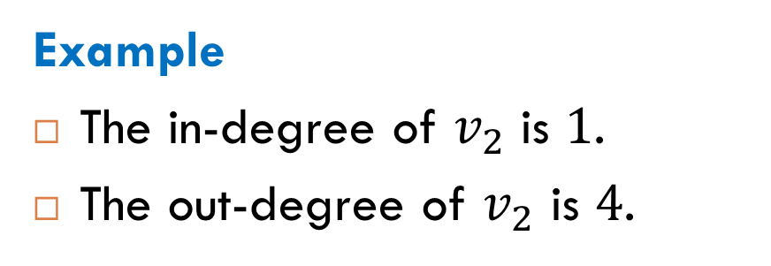

Degrees for Directed Graphs
Definition. Let $v$ be a vertex of a directed graph $G$.
The in-degree of $v$ is the number of edges incoming to $v$.
The out-degree of $v$ is the number of edges out-going from $v$.
Example
The in-degree of $v_{2}$ is $1$.
The out-degree of $v_{2}$ is $4$.

Slide 14
Special Types of Graphs

Slide 15
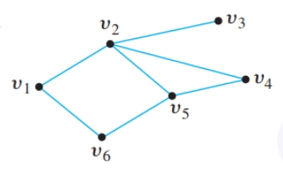
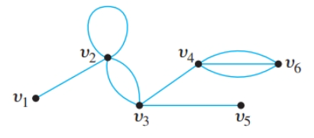
Simple Graphs
Definition. A simple graph is a graph that does not have any loops or parallel edges.
simple graph
non-simple graph

Slide 16
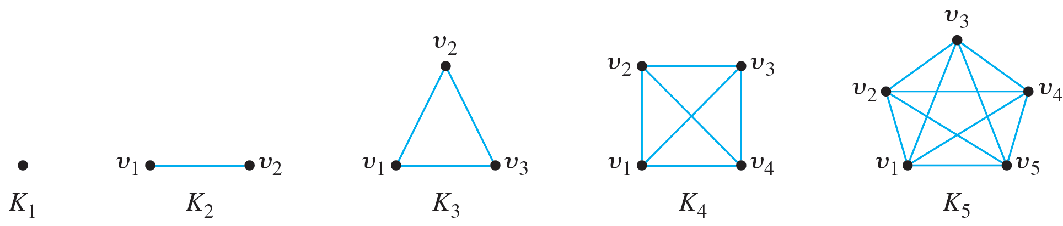

Completed Graphs
Definition. A complete graph on $n$ vertices, denoted $K_{n}$, is a simple graph with $n$ vertices where any two are adjacent.
Examples

Slide 17
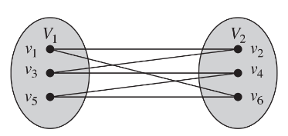
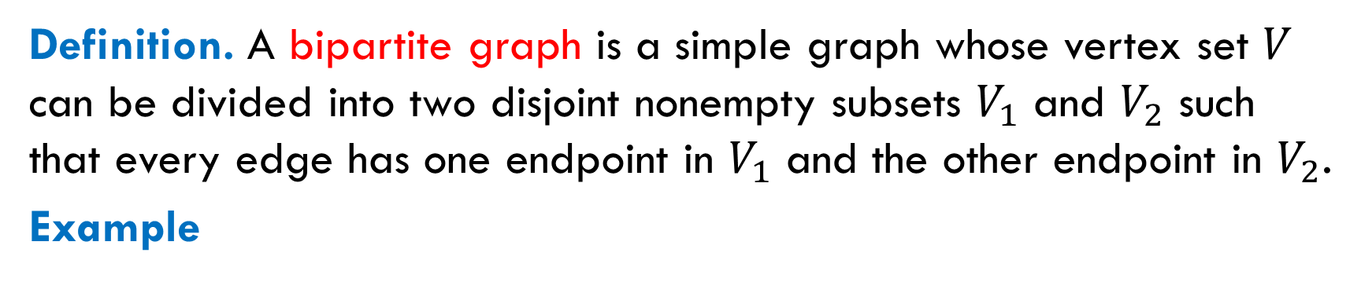
Bipartite Graphs
Definition. A bipartite graph is a simple graph whose vertex set $V$ can be divided into two disjoint nonempty subsets $V_{1}$ and $V_{2}$ such that every edge has one endpoint in $V_{1}$ and the other endpoint in $V_{2}$.
Example

Slide 18
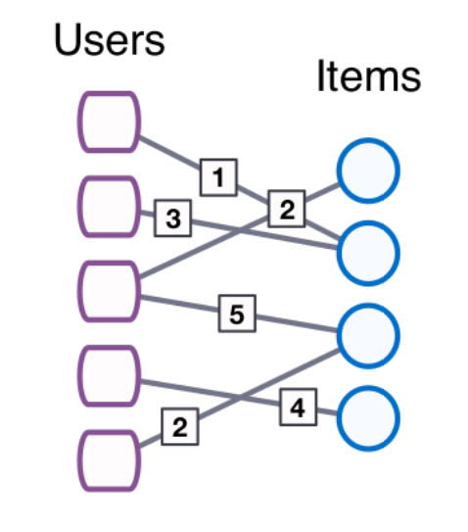
Many Applications
One of many applications is recommender networks or user-item networks.
A number assigned to an edge is a rating given by the user to the item.
Such a recommender network is used to make a prediction for a given user: which of the items will the user like?
?

Slide 19
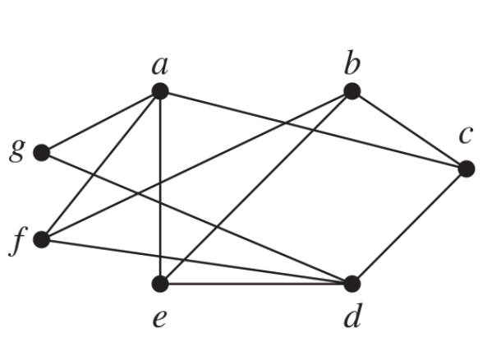
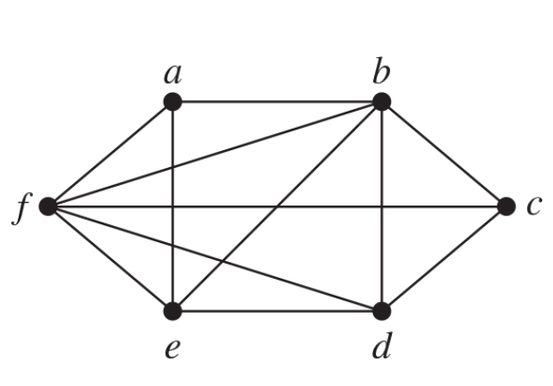

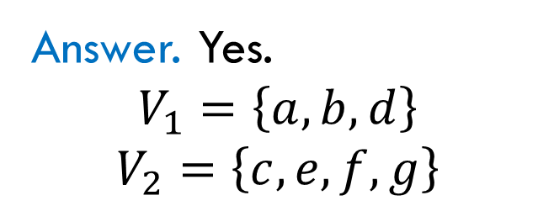
Exercise
Is this graph bipartite?
Is this graph bipartite?
Answer. Yes.
$$V_{1}=\left\{a, b, d\right\}$$
$V_{2}=\left\{c, e, f, g\right\}$
Answer. No. The graph contains “triangles”, for example $\left\{a, b, f\right\}$.

Slide 20
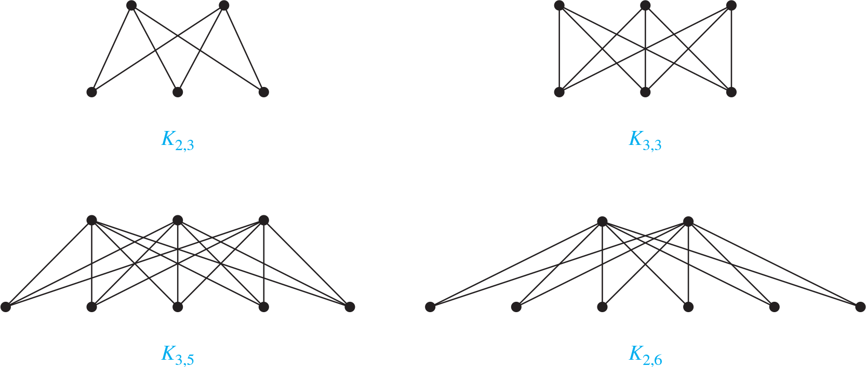
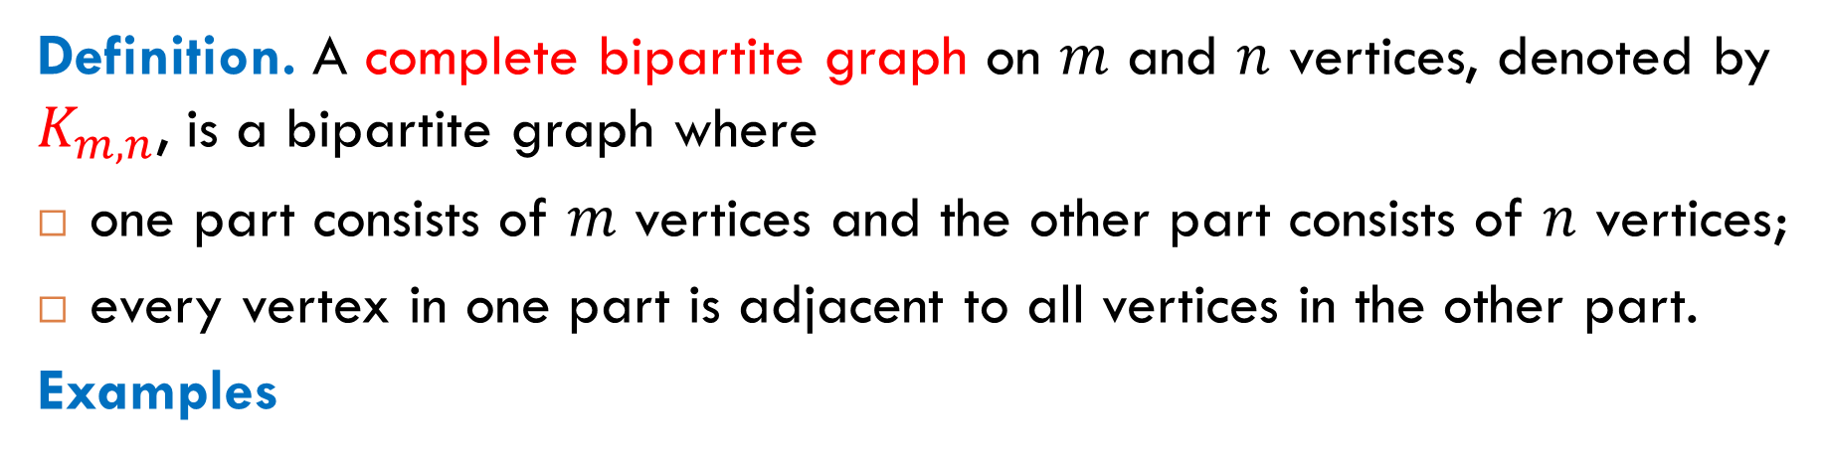
Complete Bipartite Graphs
Definition. A complete bipartite graph on $m$ and $n$ vertices, denoted by $K_{m,n}$, is a bipartite graph where
one part consists of $m$ vertices and the other part consists of $n$ vertices;
every vertex in one part is adjacent to all vertices in the other part.
Examples

Slide 21
Subgraphs and Complements

Slide 22
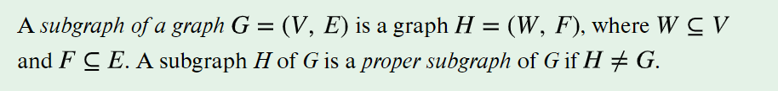
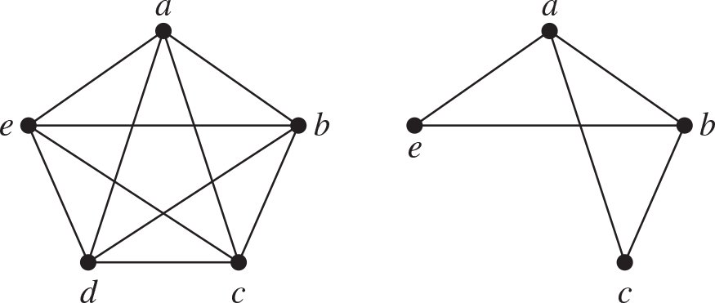
What Is a Subgraph?
graph
subgraph

Slide 23
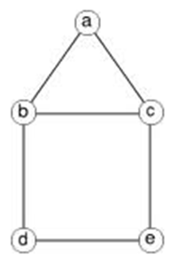
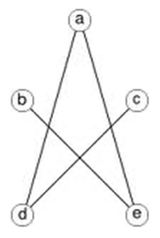

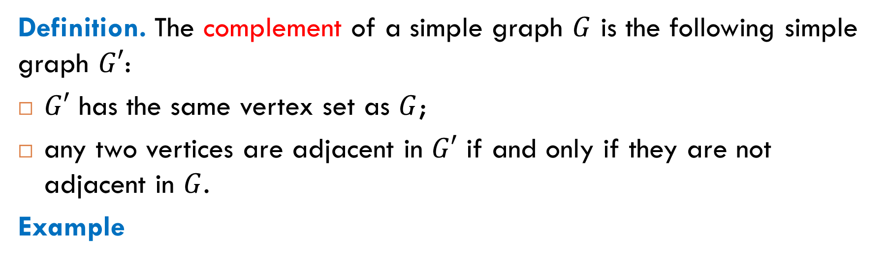

What Is a Complementary Graph?
Definition. The complement of a simple graph $G$ is the following simple graph $G′$:
$G′$ has the same vertex set as $G$;
any two vertices are adjacent in $G′$ if and only if they are not adjacent in $G$.
Example
$$G$$
$$G′$$

Slide 24

Reading
Sections 6.1, 6.4, 6.6, 6.10

